Slide 1
April Vacation Survey Results
School Committee
April 9, 2020

Slide 2
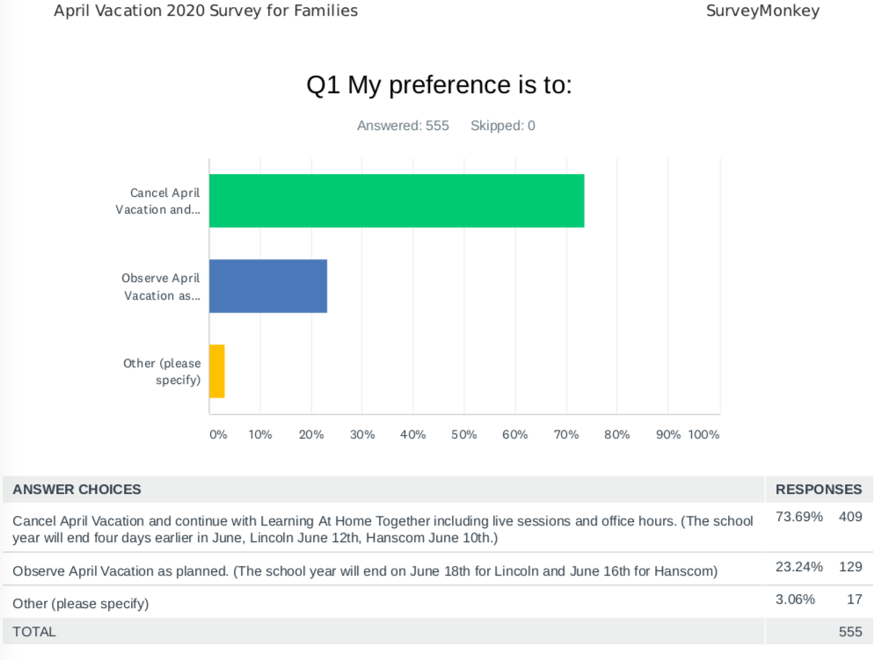
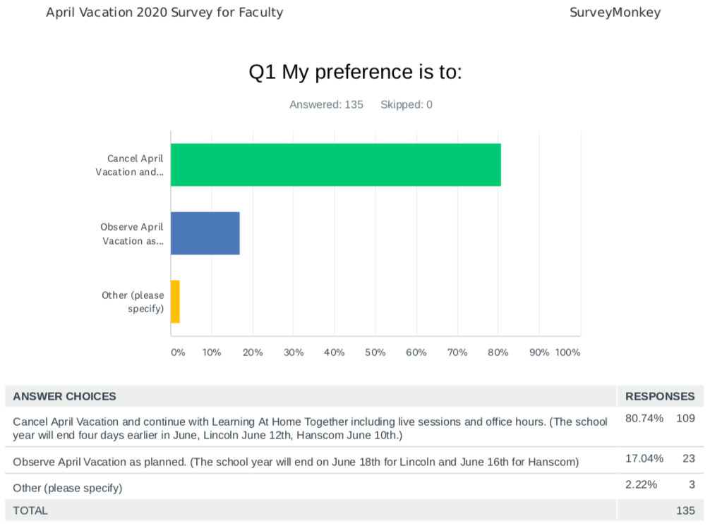

Slide 3
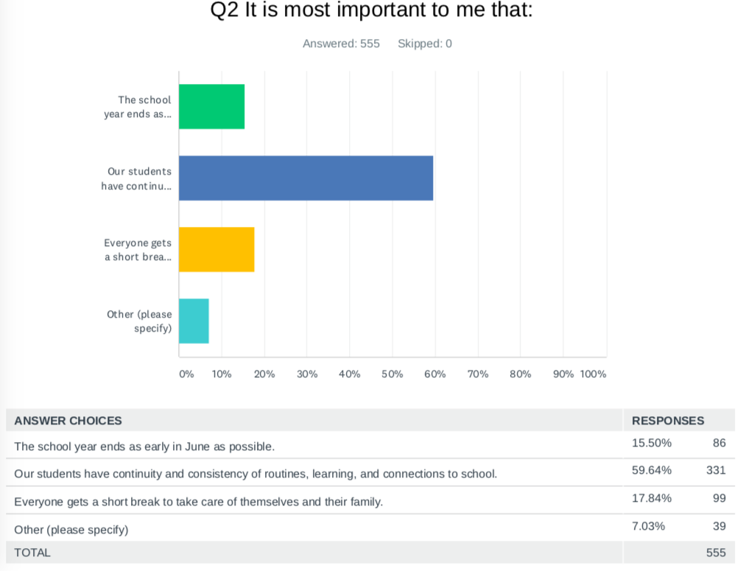
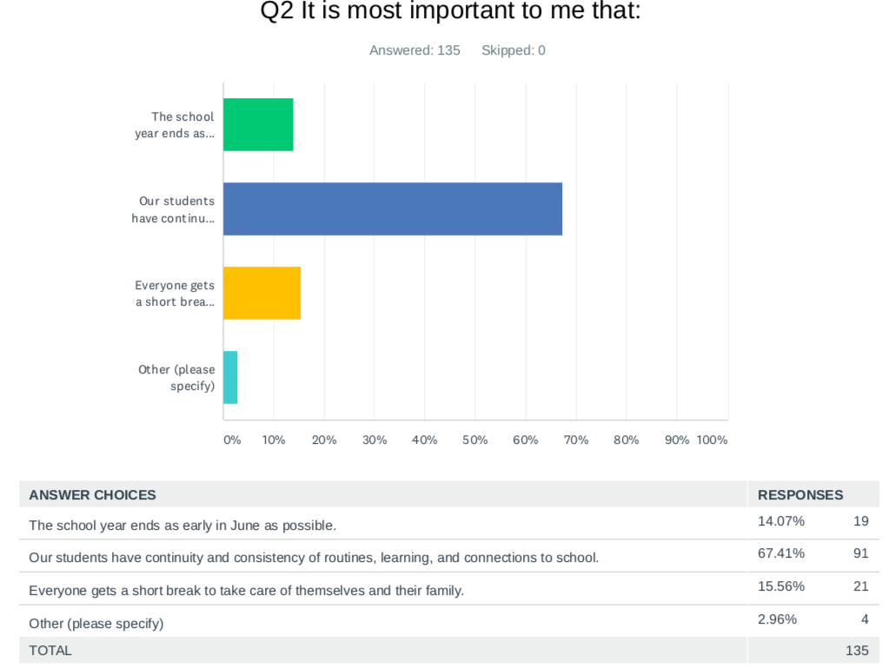

Slide 4
Q3 What else would you like us to consider?
Families
Keep vacation if we will return to school, in-school days are more valuable
Cancel vacation and extend the school year
Ending earlier is a benefit to Hanscom families who will be PCSing, moving to a new assignment, in June.
Ending early creates an additional burden on families for childcare in June, prior to camps starting.
Follow other states and close for the rest of the year, continuing remote learning.
Faculty
Observing the vacation and having a longer school year increases the chances of returning to school and being able to close the school year with our students.
Even if we take a break, teachers will be working anyway.
Everyone is exhausted and have been working nights and weekends for weeks – we need the break.
Please be consistent with other districts where our children attend school.
It has been stressful and emotional juggling work with young children at home. We need time to focus on our families for a week.
Notes:
Focusing on comments related to April vacation. There were comments about the learning experience and we will discuss that next when we provide an update on our Learning Together at Home program.

